Slide 1
AI & Machine Learning
PART B: Regression
By: Yek Yi Wei (p2107631)

Slide 2
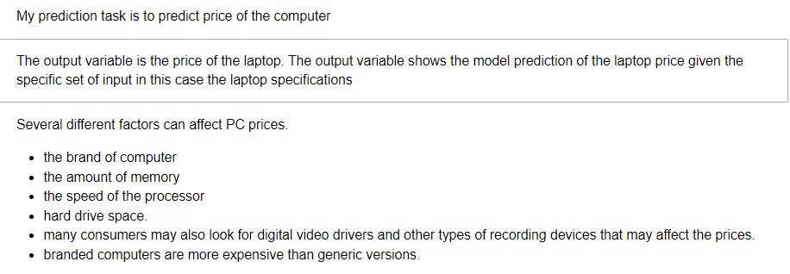
PC Price Prediction

Slide 3
Exploratory Data Analysis

Slide 4
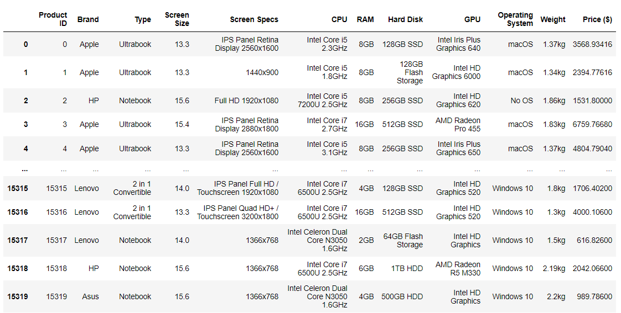
Default Dataset: pc_data.csv

Slide 5
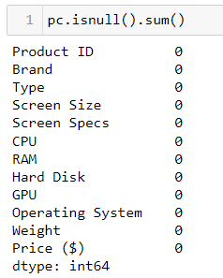
Default Dataset: pc_data.csv
No Null Values

Slide 6
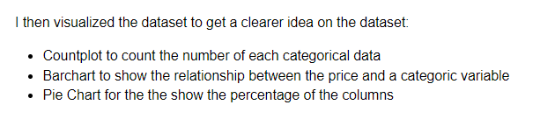
Data Exploration

Slide 7
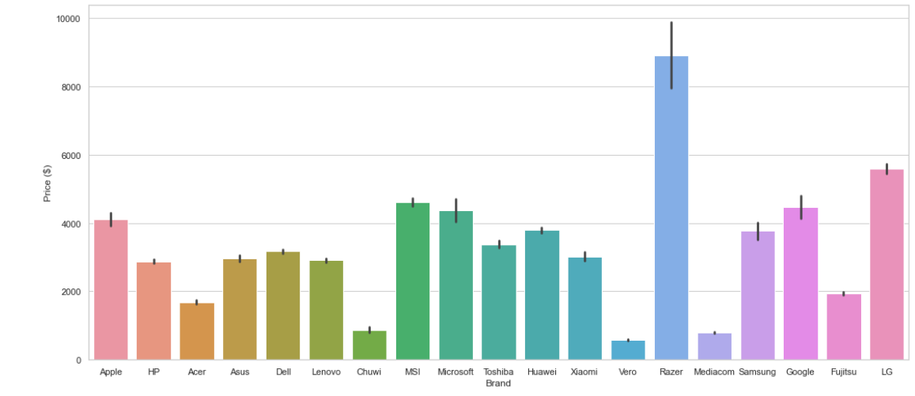
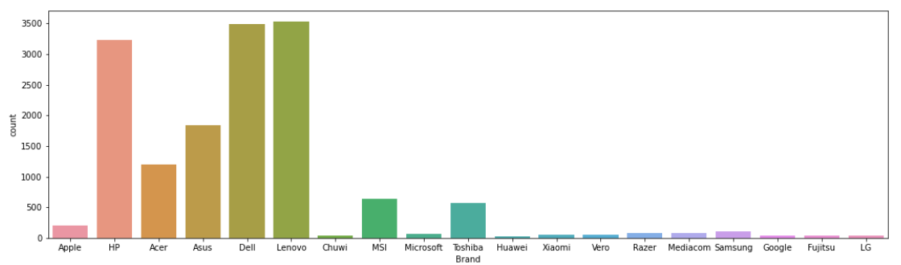
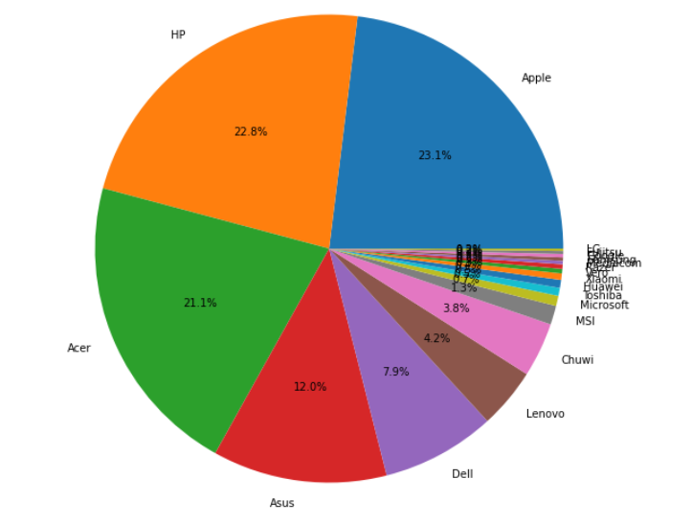
Data Exploration- Brand

Slide 8
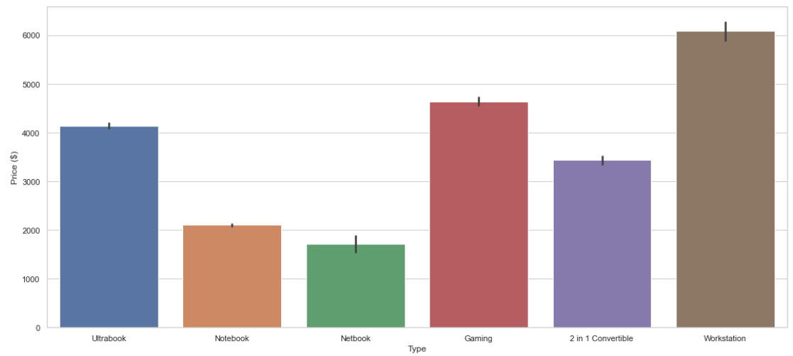
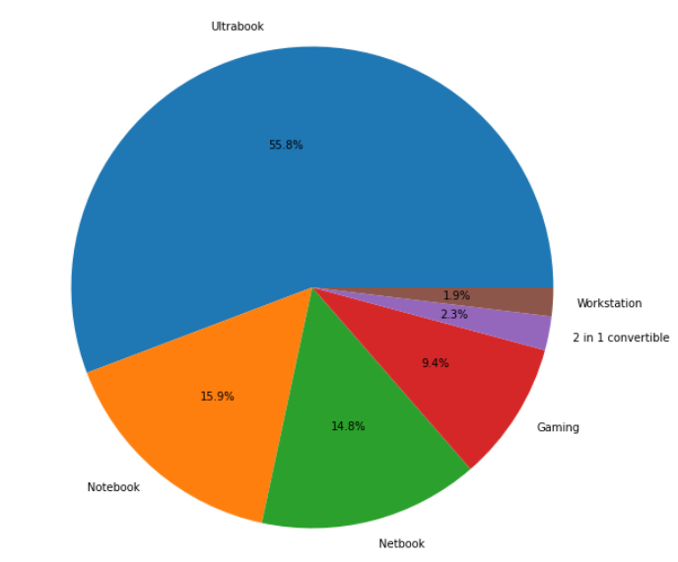
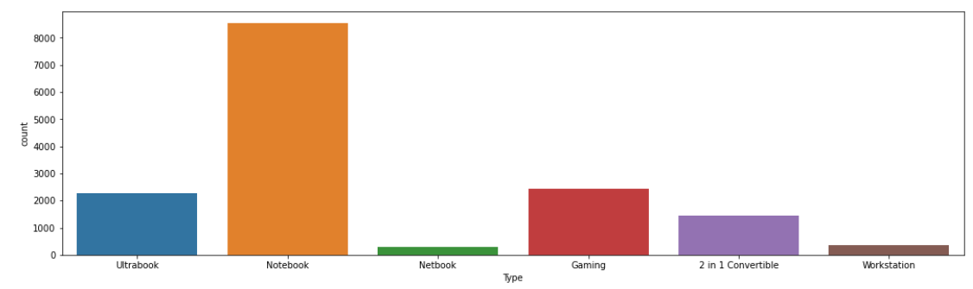
Data Exploration- Types

Slide 9
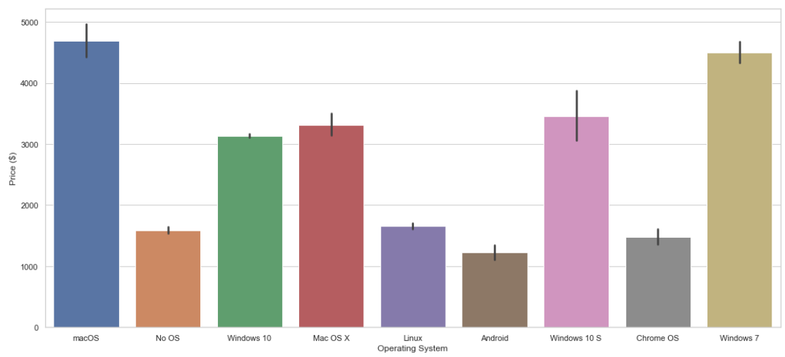
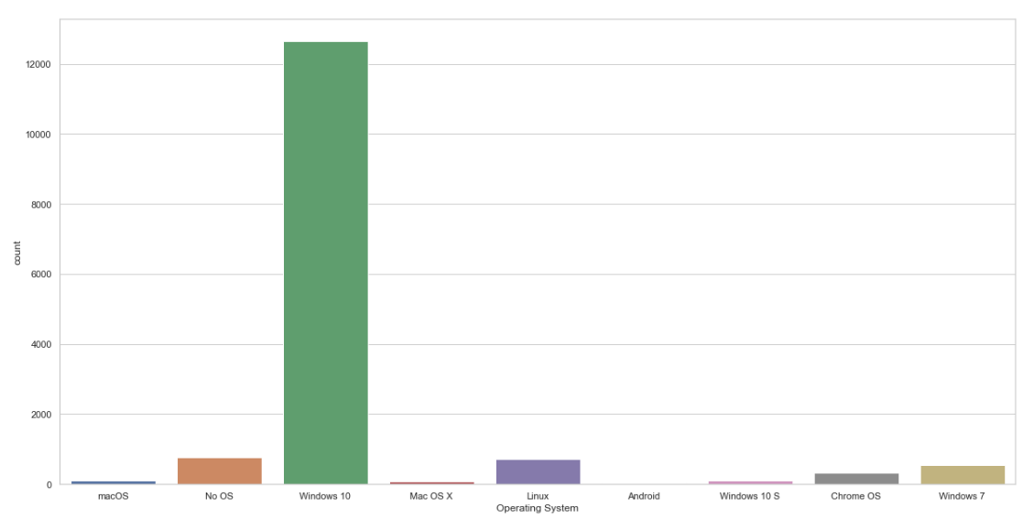
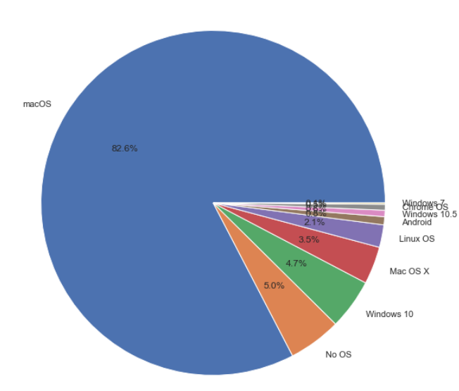
Data Exploration- Operating Systems

Slide 10
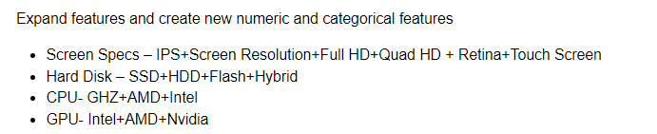
Features Engineering

Slide 11

Data Processing

Slide 12
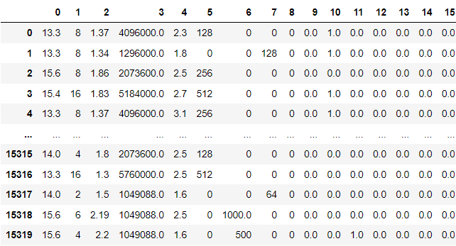
Data Encoding

Slide 13
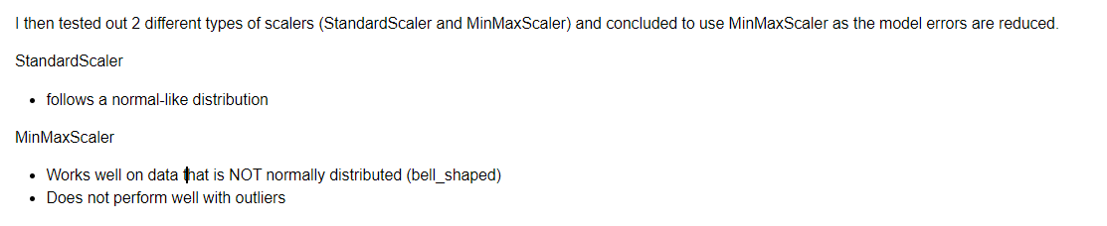
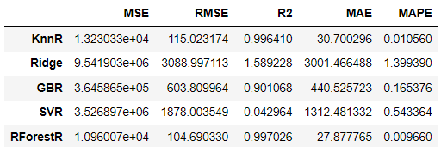
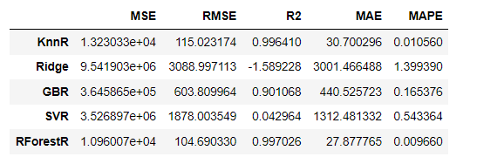
Scale Data
StandardScaler
MinMaxScaler

Slide 14
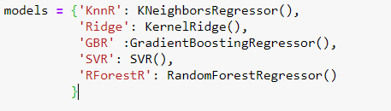
Models Used
KNeighborsRegressor
KernelRidge
GradientBoostingRegressor
Support Vector Regression (SVR)
RandomForestRegressor

Slide 15
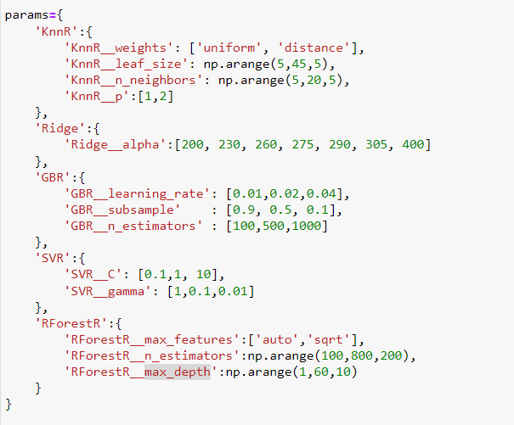
Model Selection & Hyperparameter Tuning

Slide 16
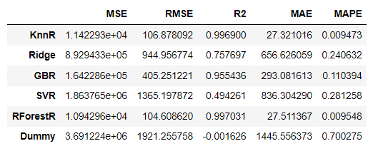
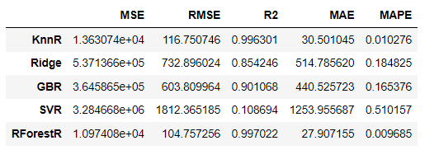
Performance Evaluation
Before Tuning
After Tuning

Slide 17
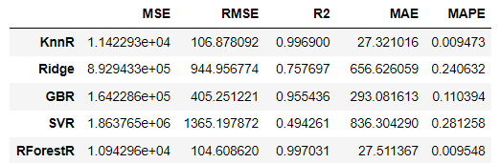
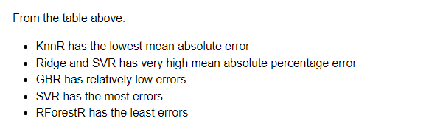
Errors

Slide 18
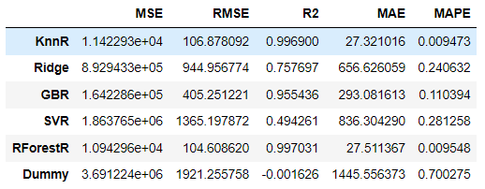
Comparison to a stupid baseline

Slide 19
